Slide 1

Progress Report
Michael Lee
July 20th, 2022

Slide 2
What was done
Phase recovery code with PyTorch & Holotorch
Code for generating synthetic WISHED [add citation here] data
Used PyTorch optimization, NOT Gerchberg-Saxton
PyTorch optimization converges faster than G.S.
Say something about models
Bug finding

Slide 3
CONTEXT AND BACKGROUND

Slide 4
FIRST PROBLEM TO SOLVE
How to recover optical wavefronts?

Slide 5
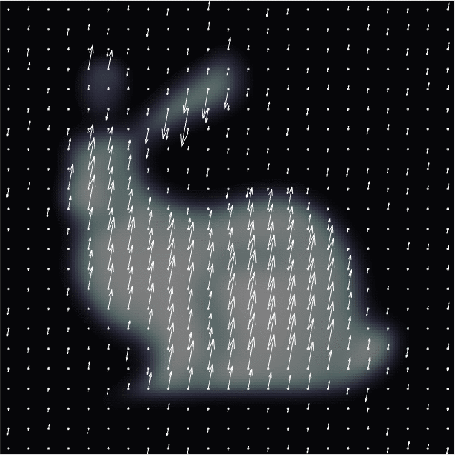
Objective
Want to reconstruct optical wavefronts
I.e. recover amplitude and phase of optical fields
Field has…
Amplitude (arrow length)
and
Phase (oscillation offsets)

Slide 6
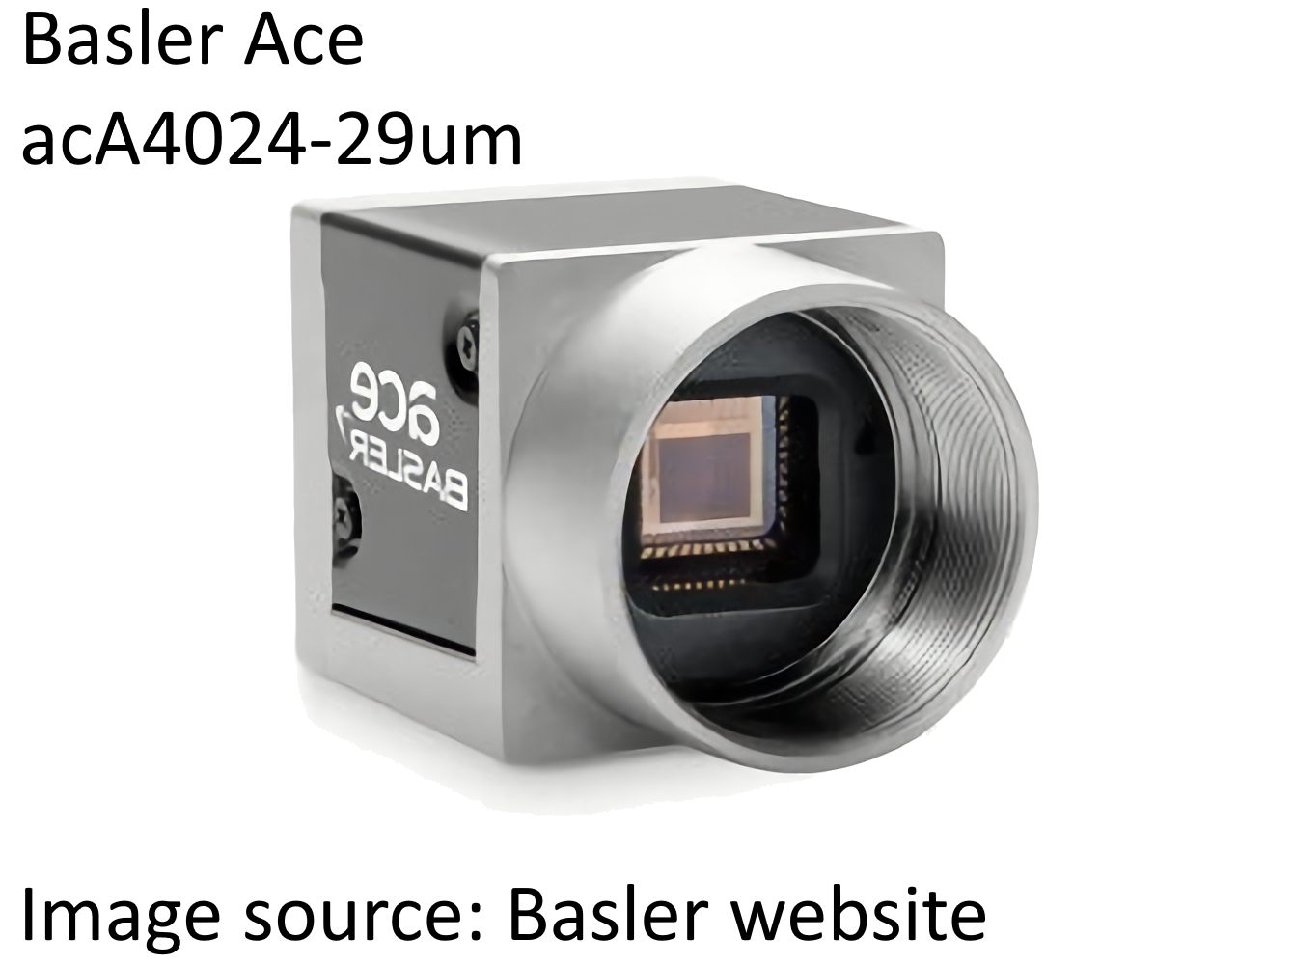
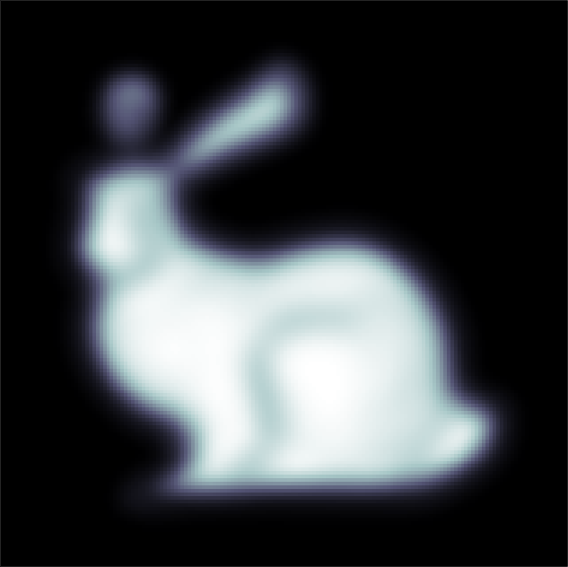
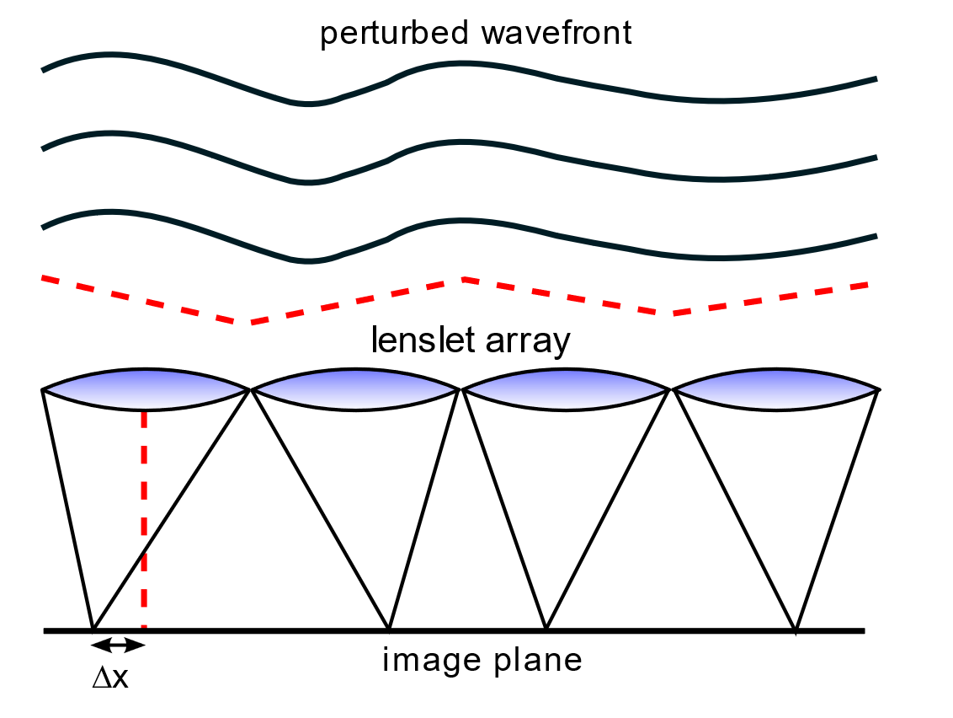
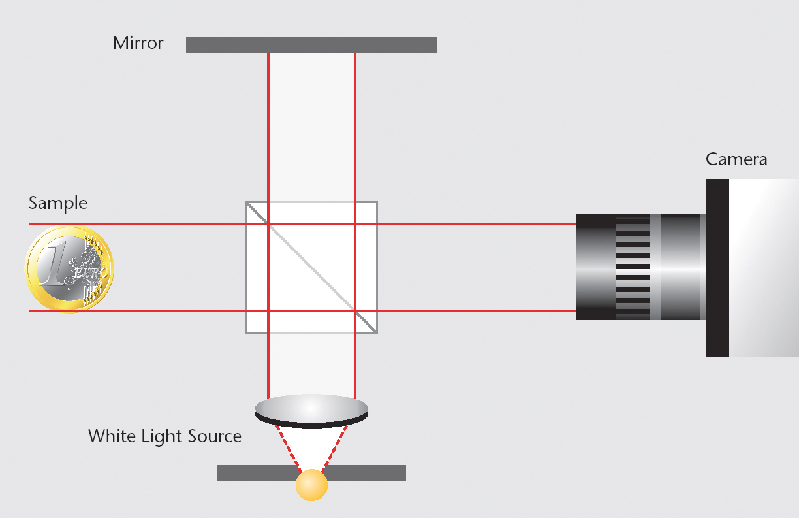
Why is wavefront recovery difficult?
Use a typical camera sensor?
What about interferometry?
Sensitive to minute movements (e.g. vibration)
Calibration difficulty
Standard CCD/CMOS sensors
only capture intensity
Shack-Hartmann wavefront sensor?
Low resolution
Why not just sample the fields?
(Like an oscilloscope?)
Optical frequencies: > 400 THz
No ADCs for those frequencies
Source: Wikimedia
https://commons.wikimedia.org/wiki/File:Interferometer_Schema.jpg
Source: Wikimedia
https://commons.wikimedia.org/wiki/File:Shack_Hartmann_WFS_lensletarray.svg

Slide 7
Why is this useful?
Obtaining depth maps of objects
Phase microscopy?

Slide 8
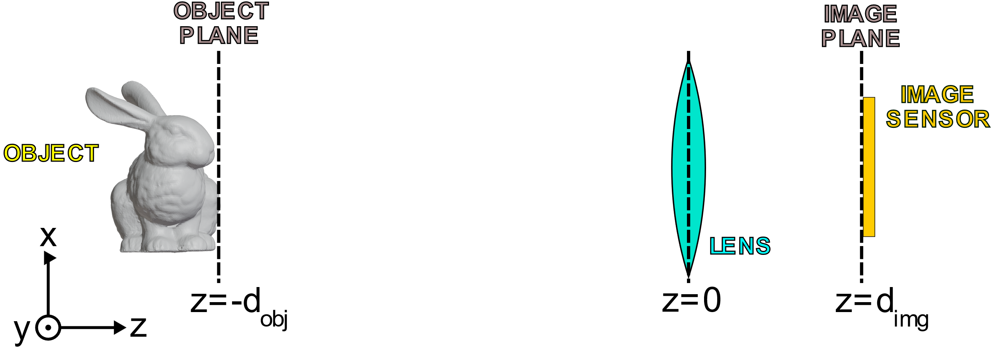
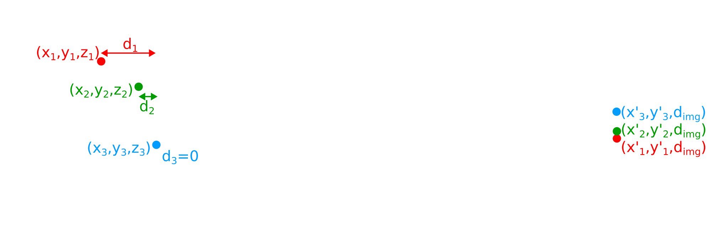
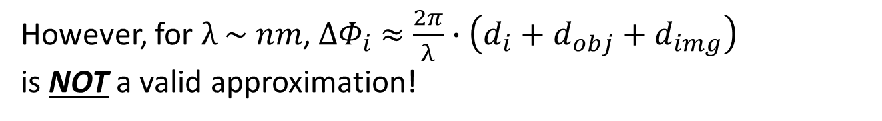

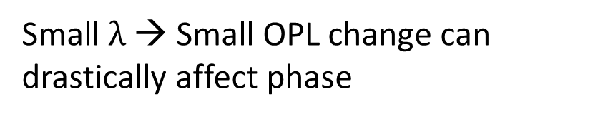
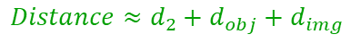
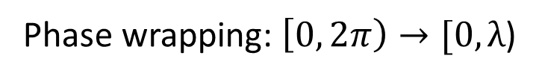
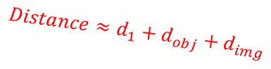
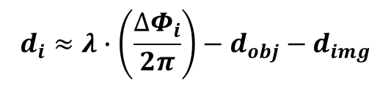
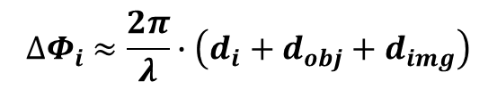
Phase and Depth
$$Distance≈d_{1}+d_{obj}+d_{img}$$
$$Distance≈d_{2}+d_{obj}+d_{img}$$
$$Distance≈d_{3}+d_{obj}+d_{img}$$
Phase wrapping: $\left[0, 2π\right)→[0,λ$)
Small $λ$ → Small OPL change can drastically affect phase
Optical path lengths (OPL) are all equal
(ideal case)
Phase shift over path is proportional to OPL
$${∆Φ}_{i} ≈\frac{2π}{λ}∙\left(d_{i}+d_{obj}+d_{img}\right)$$
However, for $λ \sim nm$, ${∆Φ}_{i} ≈\frac{2π}{λ}∙\left(d_{i}+d_{obj}+d_{img}\right)$
is NOT a valid approximation!
If the object is sufficiently far away…
Why?
$$d_{i}≈λ∙\left(\frac{{∆Φ}_{i}}{2π}\right)−d_{obj}−d_{img}$$

Slide 9
Mention that even tiny changes in OPL can lead to big phase differences
Can assume that as object distance gets large, distance between point on object and corresponding point on image converges to the difference in their z-components
Probably cannot assume for phase. Slight changes in image plane location, as well as slight contribution of transverse displacement between point on object and point on image to distance between those points can still have a non-negligible effect.
This arises because wavelength is extremely small. E.g. micrometer shift in image plane location negligible to distance, but non-negligible to phase shift.
Synthetic wavelength holography can help with this as the synthetic wavelengths are larger and thus phase is not as sensitive to small changes in distance.

Slide 10
Need way to observe effects of phase
Standard camera sensors cannot measure phase
However, SLMs are affected by phase
Can use SLM to get effects of phase to manifest in sensor image

Slide 11
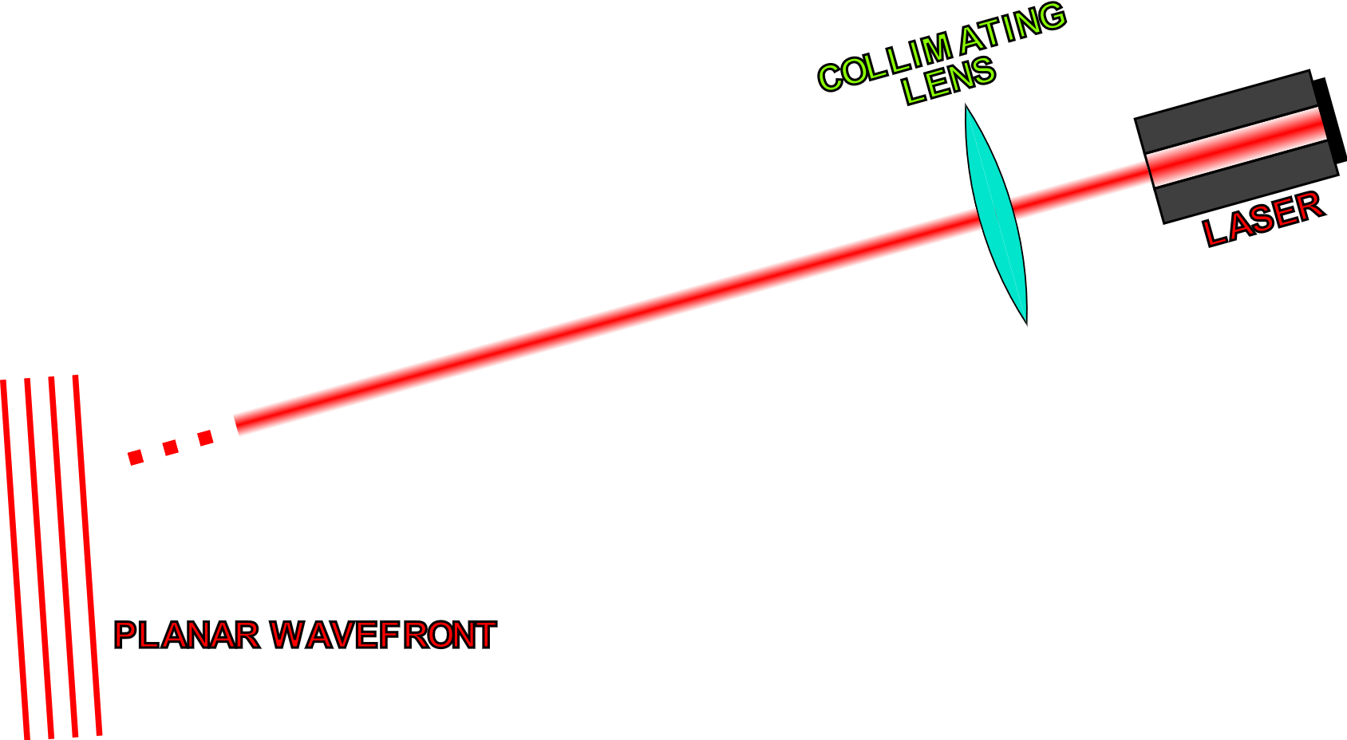
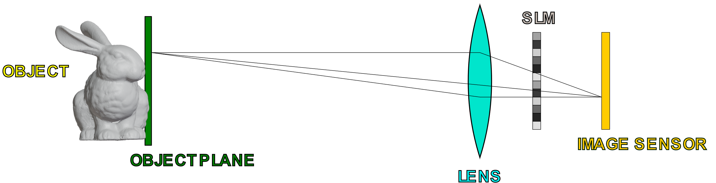
Basic Setup

Slide 12
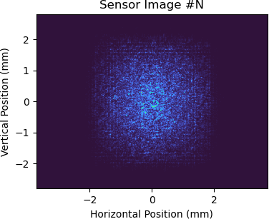
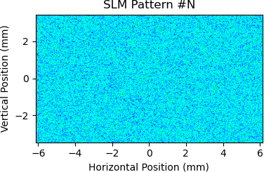
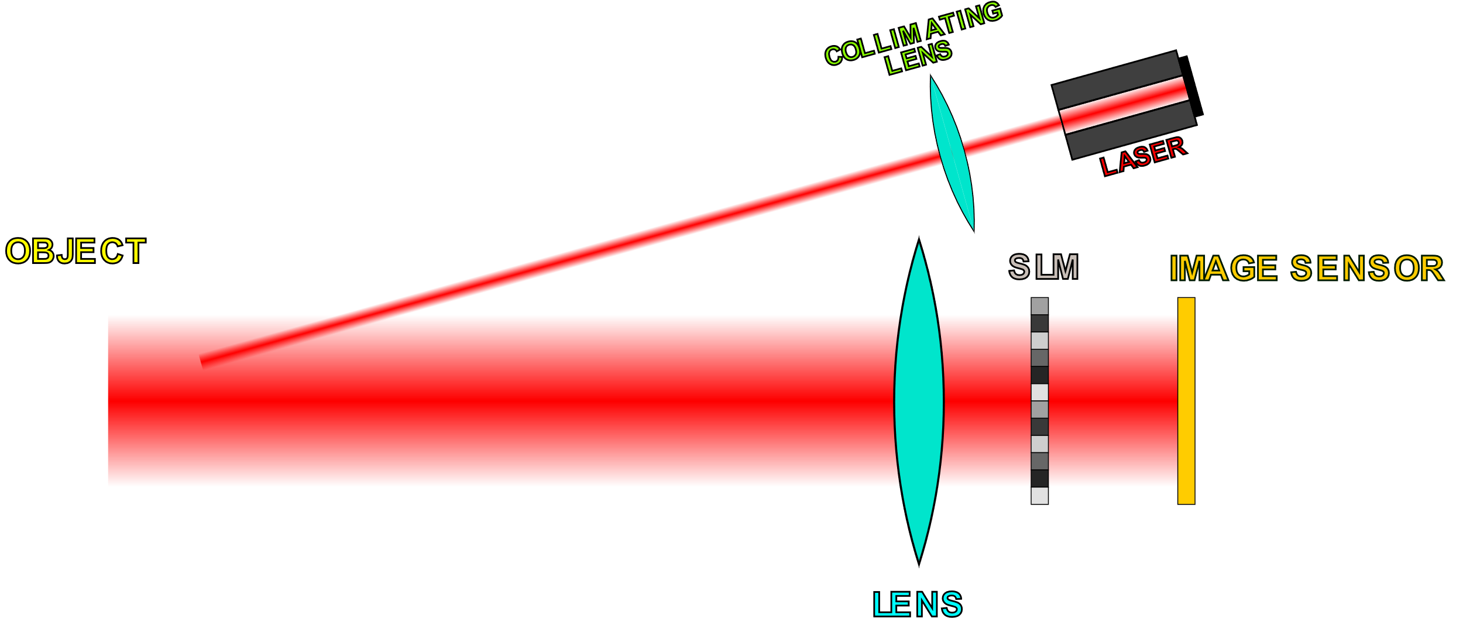
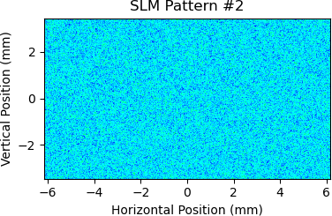
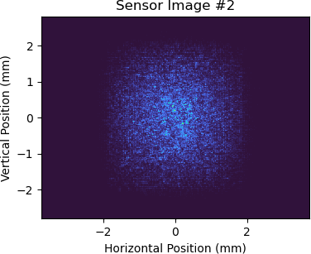
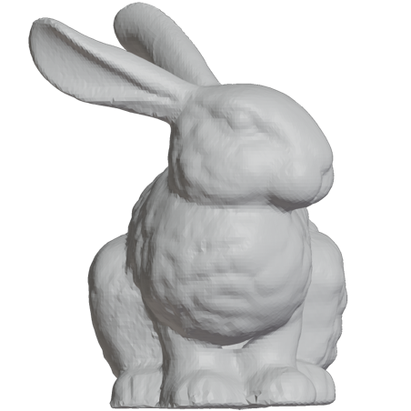
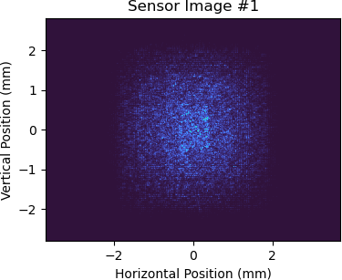
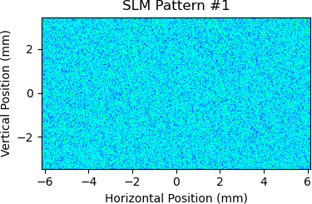
Obtaining Real (Non-Synthetic) Data
Save SLM and sensor data
Recorded Data
Acquire image from sensor
…
Display random phase pattern on SLM
Can use this data in conjunction with a model for SLM-to-sensor propagation to recover the complex field at the image sensor

Slide 13
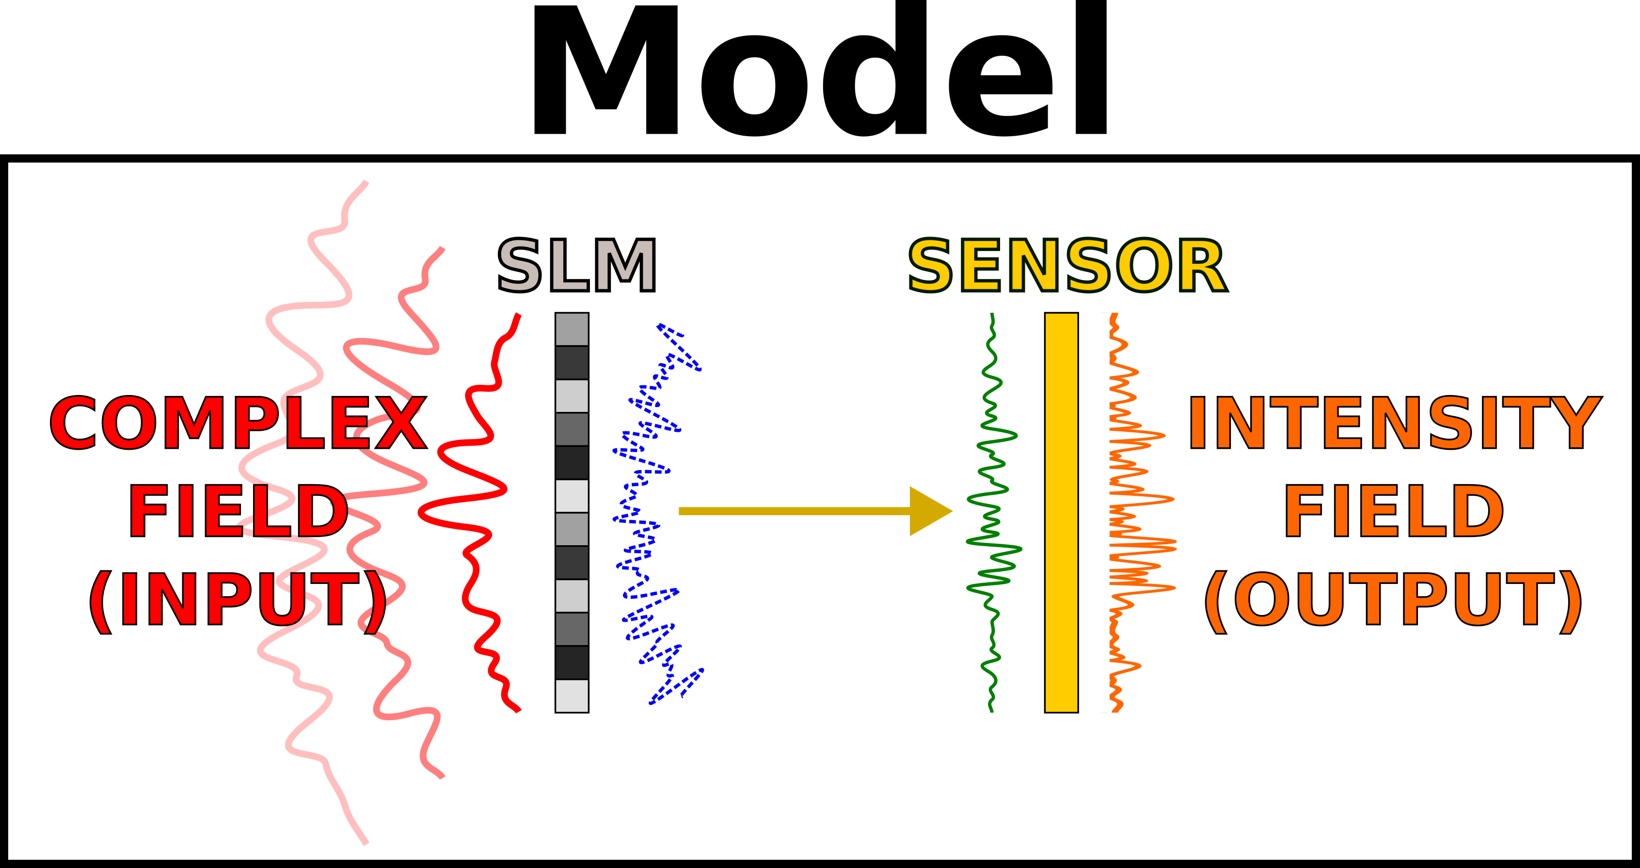
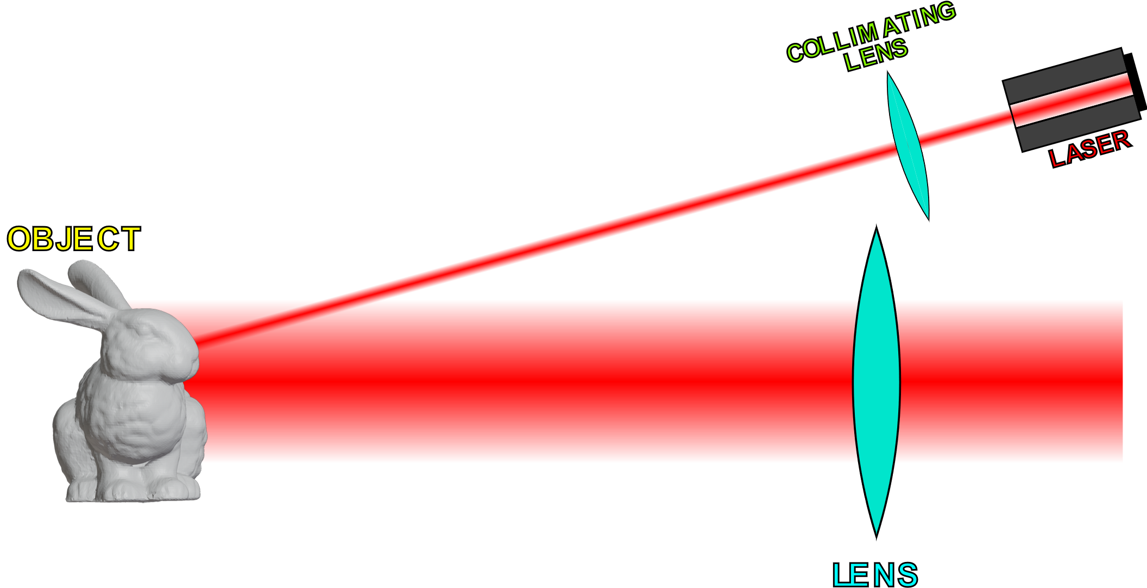
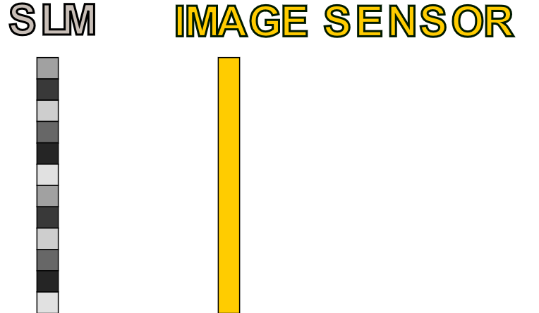
Recovering Complex Fields
Objective
Recover field (phase + amplitude) at
the image sensor
Phase Retrieval
Algorithm
Sensor Plane
Complex Fields
Can do phase retrieval
to accomplish this
…
SLM Patterns
and
Sensor Data
Can focus on SLM and sensor
while disregarding the rest

Slide 14
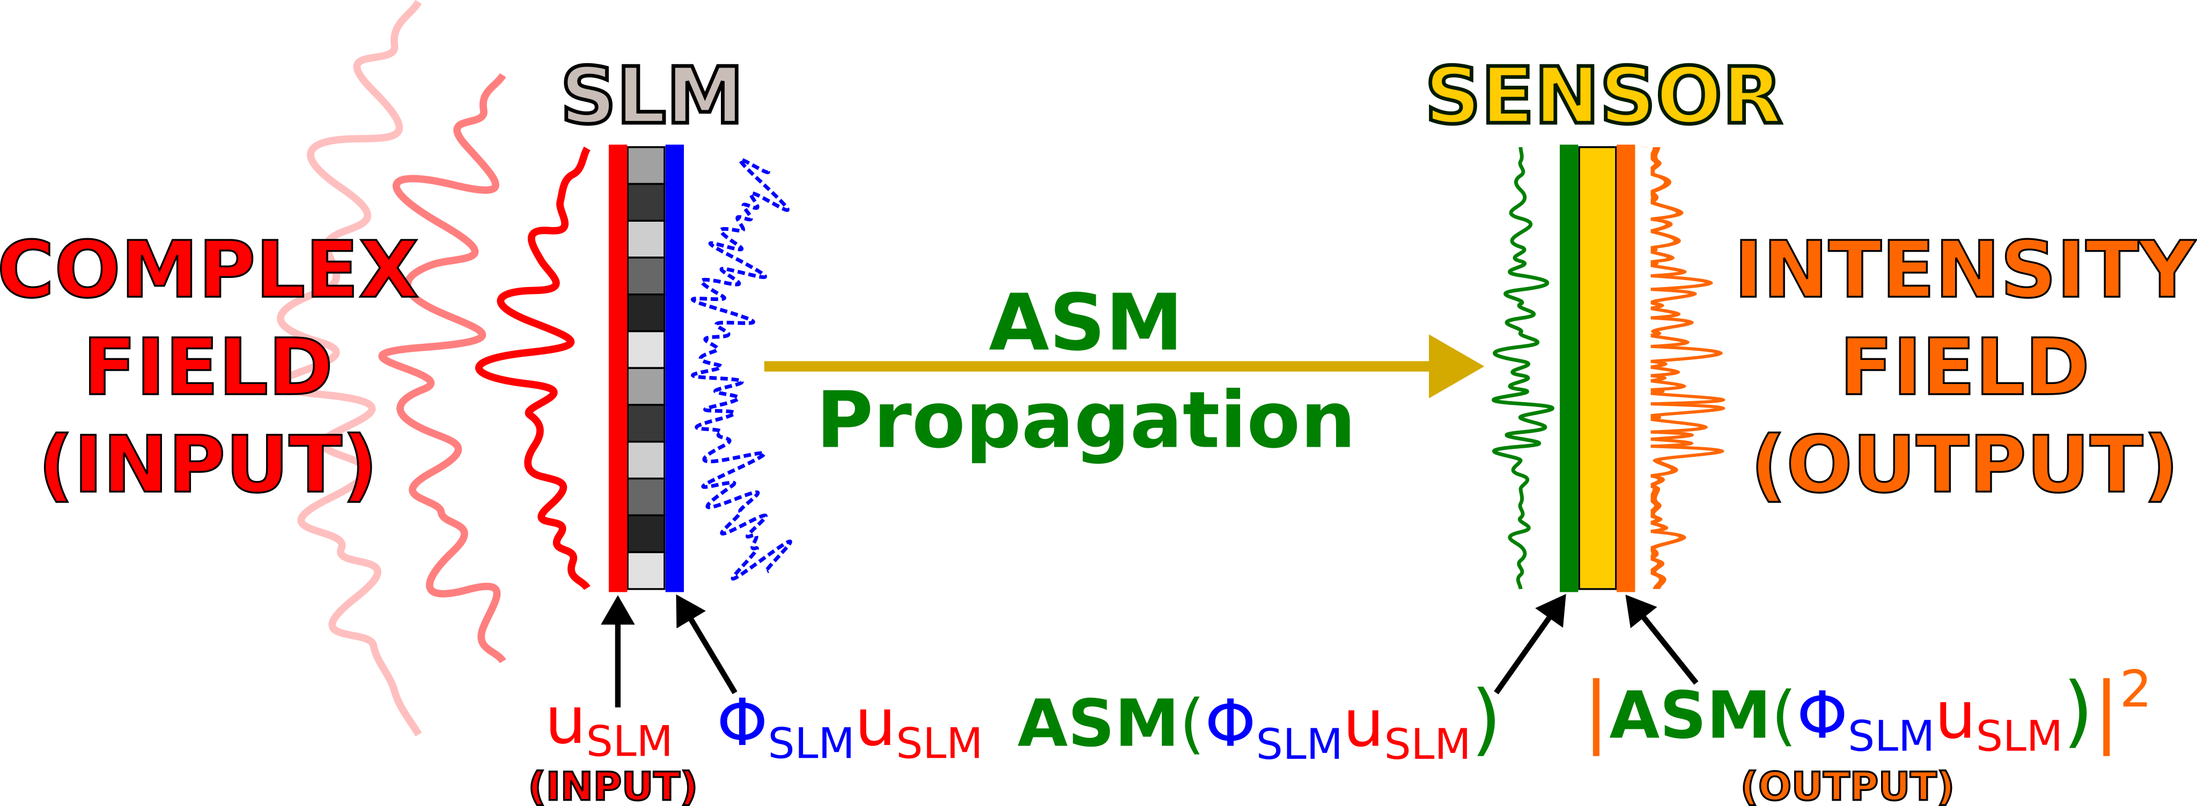
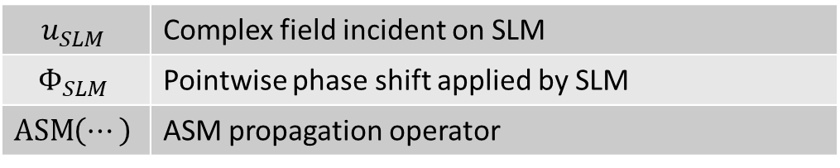
Forward Model
$$u_{SLM}$$ | Complex field incident on SLM
$$Φ_{SLM}$$ | Pointwise phase shift applied by SLM
$$\operatorname{ASM}\left(⋯\right)$$ | ASM propagation operator

Slide 15
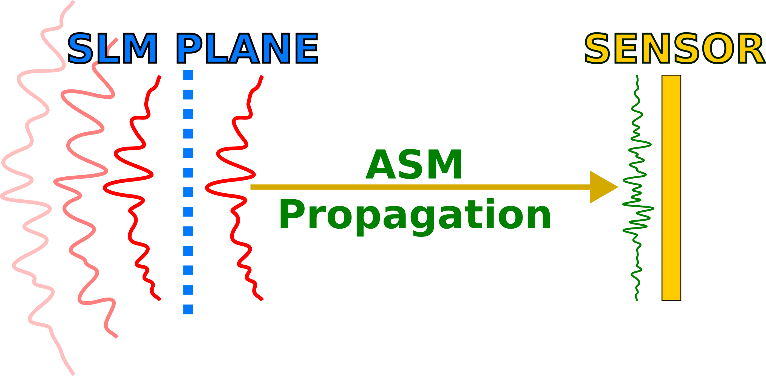
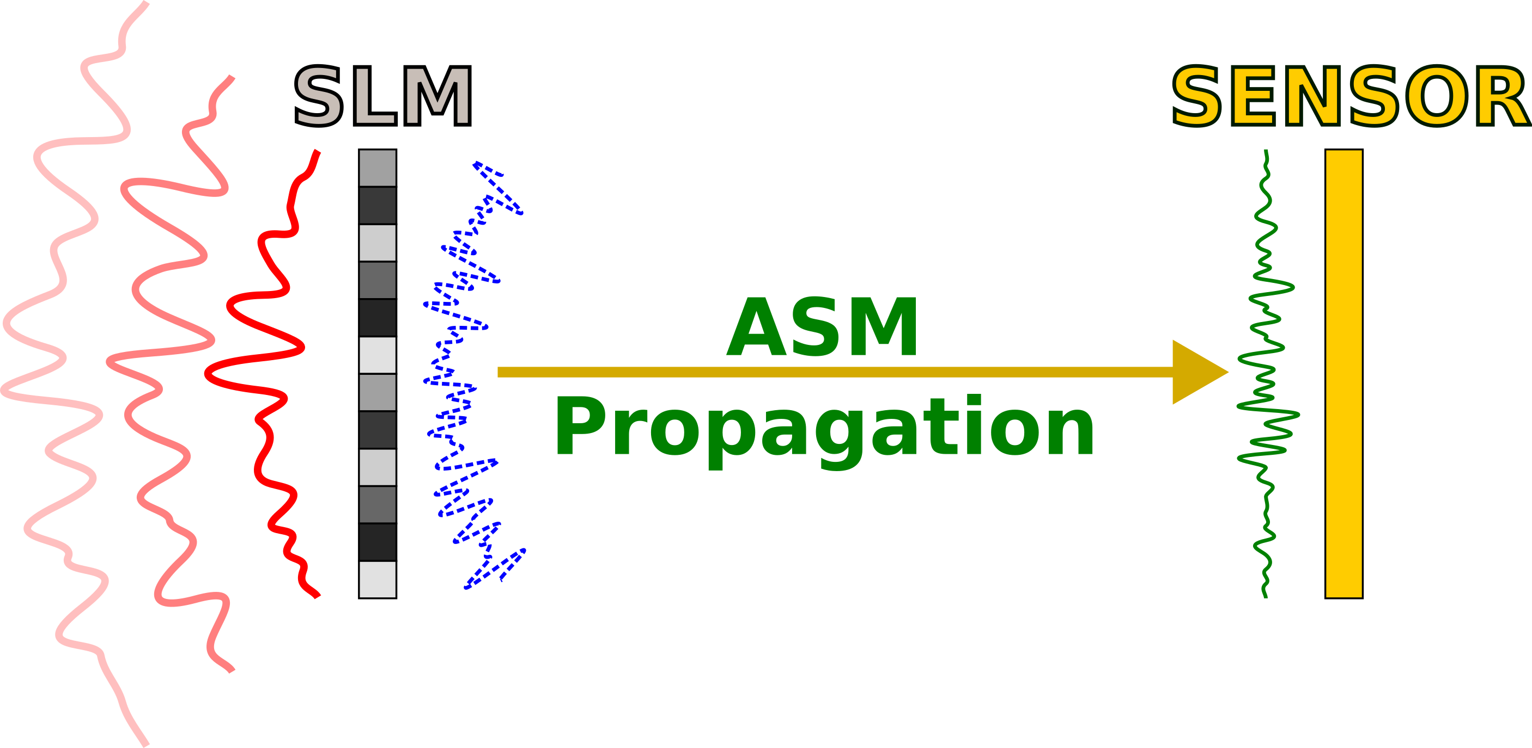
Recovering Sensor Plane Field (Part 1)
Suppose one knew the

Slide 16
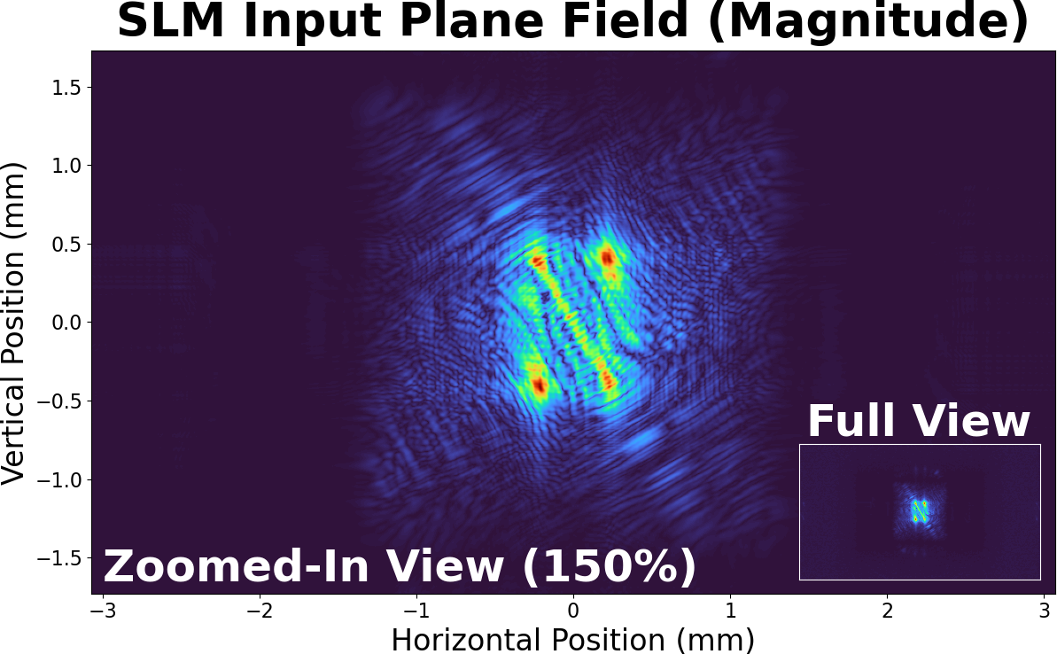
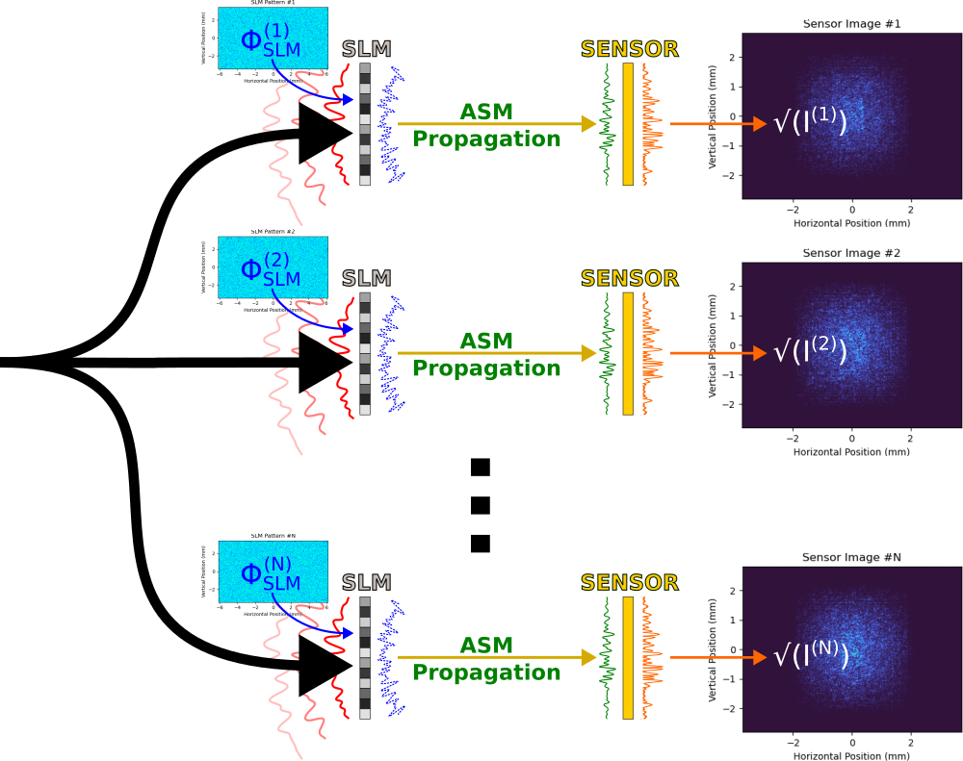
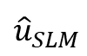
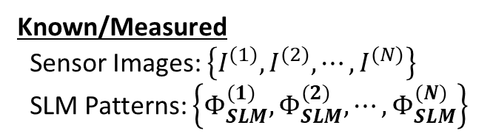
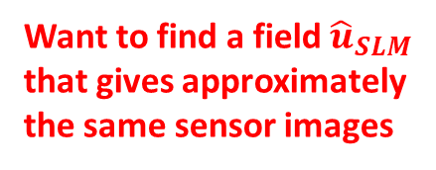
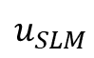
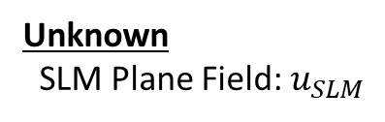
Estimating SLM Input with Optimization
?
Unknown
SLM Plane Field: $u_{SLM}$
$$u_{SLM}$$
Want to find a field ${\hat{u}}_{SLM}$ that gives approximately the same sensor images
$${\hat{u}}_{SLM}$$
Known/Measured
Sensor Images: $\left\{I^{(1)},I^{(2)},⋯,I^{(N)}\right\}$
SLM Patterns: $\left\{Φ_{SLM}^{(1)},Φ_{SLM}^{(2)},⋯,Φ_{SLM}^{(N)}\right\}$

Slide 17
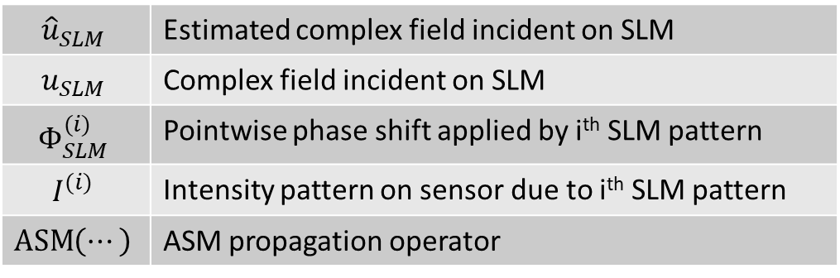
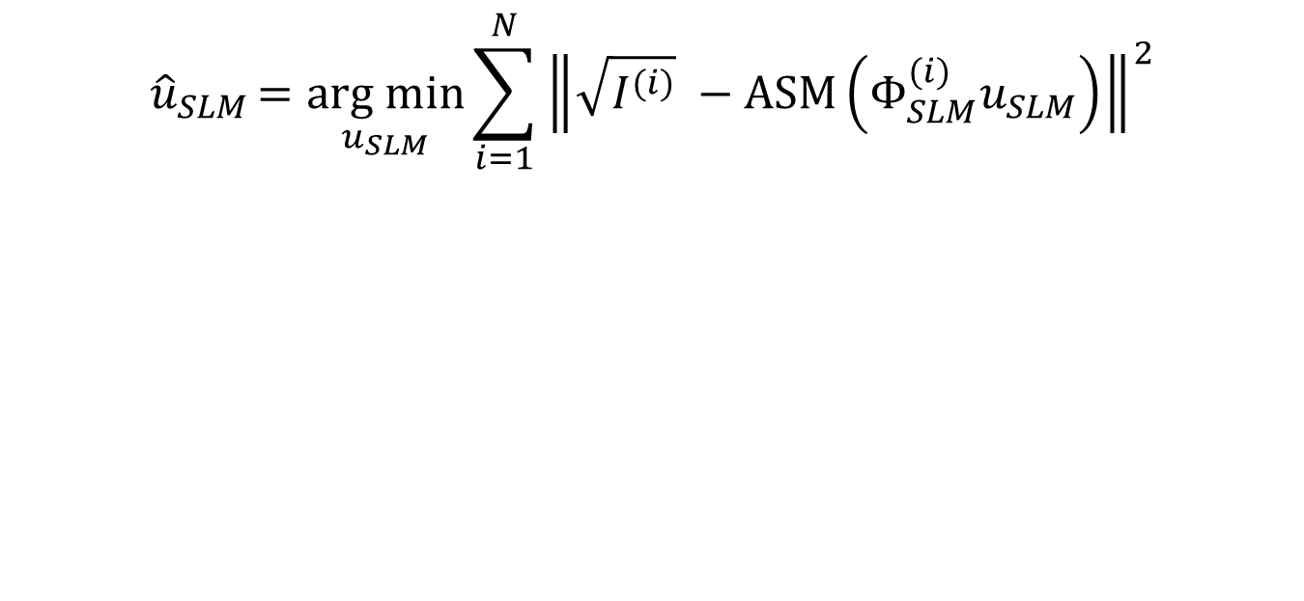
Optimization Objective Function
$${\hat{u}}_{SLM}=\underset{u_{SLM}}{arg min}{\sum_{i=1}^{N}{{\left\|\sqrt{I^{(i)}} −\operatorname{ASM}\left(Φ_{SLM}^{(i)}u_{SLM}\right)\right\|}^{2}}}$$
CORE IDEA |
Minimize (mean-)squared error between measured intensity patterns and intensity patterns output by model
$${\hat{u}}_{SLM}$$ | Estimated complex field incident on SLM
$$u_{SLM}$$ | Complex field incident on SLM
$$Φ_{SLM}^{(i)}$$ | Pointwise phase shift applied by i^{th} SLM pattern
$$I^{(i)}$$ | Intensity pattern on sensor due to i^{th} SLM pattern
$$\operatorname{ASM}\left(⋯\right)$$ | ASM propagation operator

Slide 18
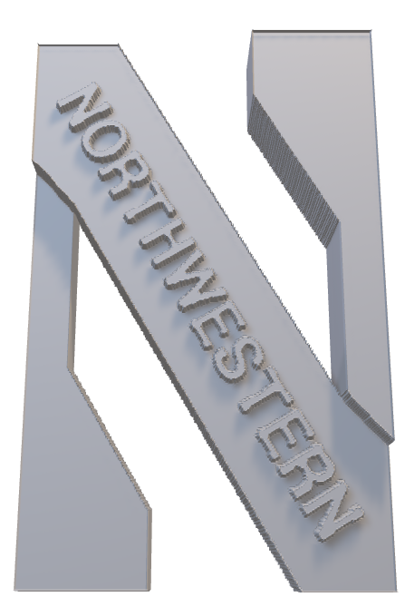
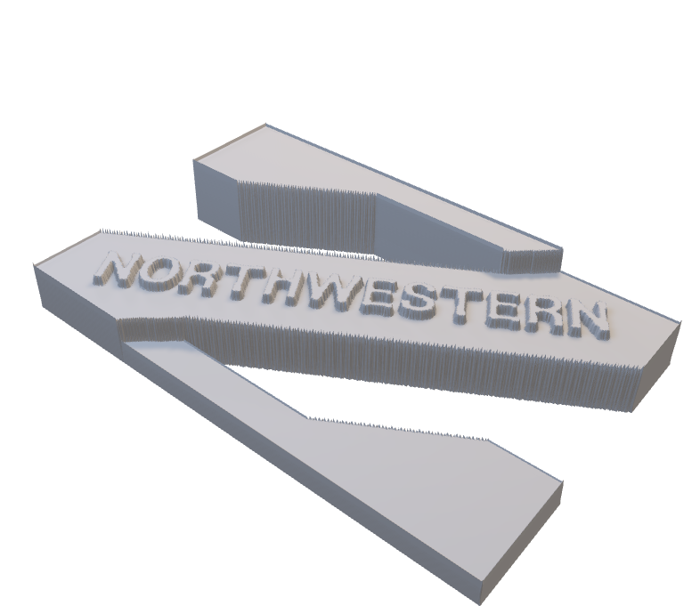

Slide 19
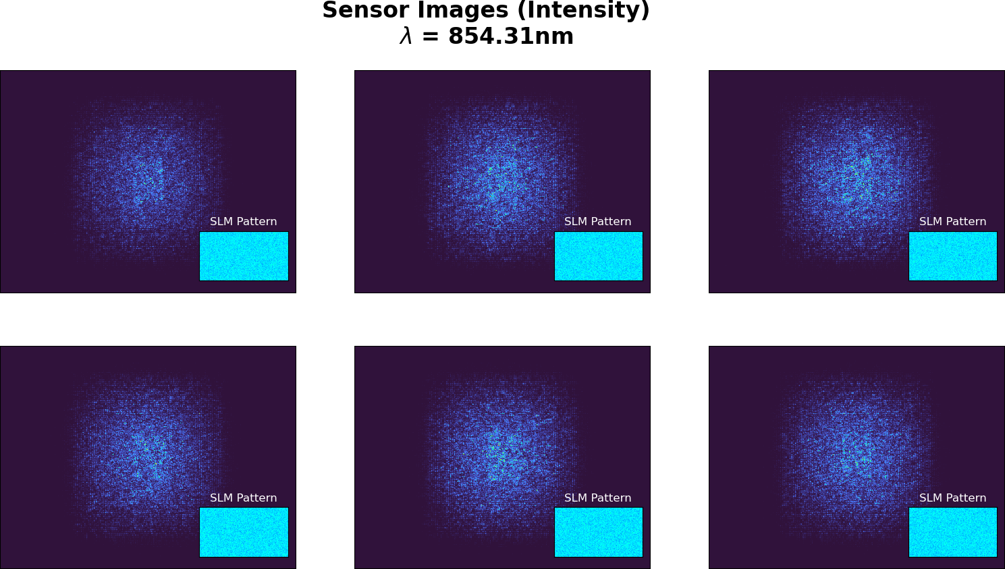
Synthetic Data Example

Slide 20
Note phase only SLM
Note that PyTorch/Holotorch works quite well
Mention assumption that the field at the SLM plane when there is no SLM present would be the same field that gets “input” to the SLM

Slide 21
Implementation Details

Slide 22


Slide 23
Stuff to add
Pictures of SLM patterns
Pictures of intensity patterns
Stuff about Gerchberg-Saxton
I.e. how inverting propagation was done

Slide 24
Stuff to improve
Readability of labels

Slide 25
Other
Write for an audience who is not familiar with the work
Specify the problem being solved
I.e. given intensity patterns from SLMs, recover phase at plane before SLM

